Slide 1
Yelp Analysis
He Guo

Slide 2
Yelp API
The current study get business data from Yelp API. The study use longitude and latitude data from Yelp API to plot the map of business in Boston.

Slide 3
API Data for Boston
The current study get business data from Yelp API. The study use longitude and latitude data from Yelp API to plot the map of business in Boston.

Slide 4
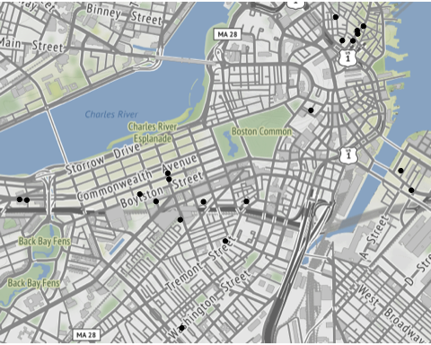
Business in Boston

Slide 5
API Data for New York
The current study get business data from Yelp API. The study use longitude and latitude data from Yelp API to plot the map of business in New York.

Slide 6
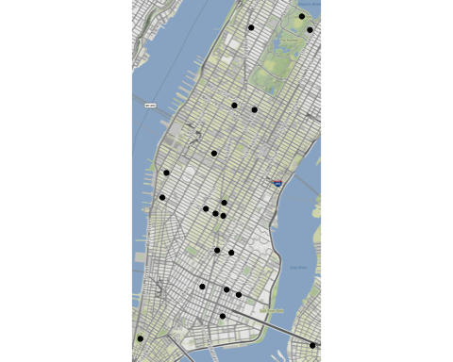
Business in NYC

Slide 7
Cluster Analysis for business dataset
This study want to apply cluster analysis to get the sub group of yelp business data set. The study want to see each business in yelp business dataset in the same subgroup to be similar, and businesses in yelp business dataset from different subgroup to be different.

Slide 8
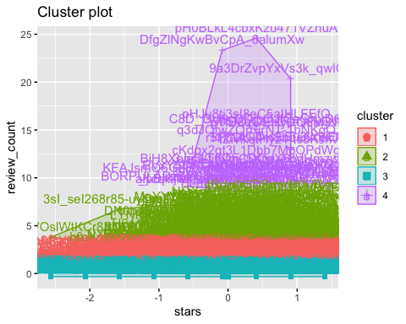
Cluster for Business in Yelp

Slide 9
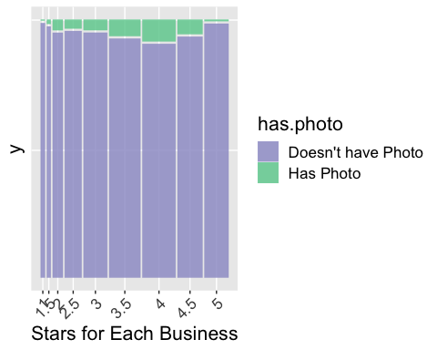
Distribution of Stars of business in Yelp vs Has photo or not

Slide 10
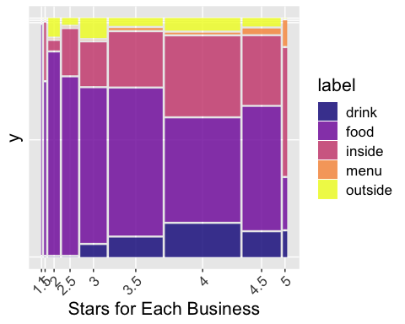
Distribution of Stars of business in Yelp vs Label of Photo

Slide 11
Yelp Review Analysis
This study use review file in Yelp dataset and applies text analysis to analysis the review from users in Yelp.

Slide 12
Sentiment
According to the following plot, users post positive review to business in High and mid Rate. Users post a higher positive sentiment score to business in High Rate. There are some negative score to business in low Rate. It means that people will post neigative review to business in low Rate.

Slide 13
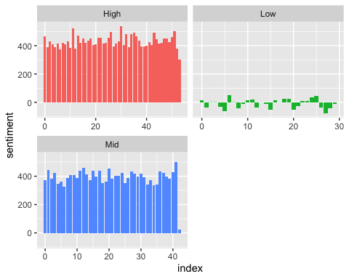
Sentiment Plot

Slide 14
Words Contirbutes
How much each word contributed to positive and negative sentiment?

Slide 15
Words Contirbutes Plot
## Selecting by n

Slide 16
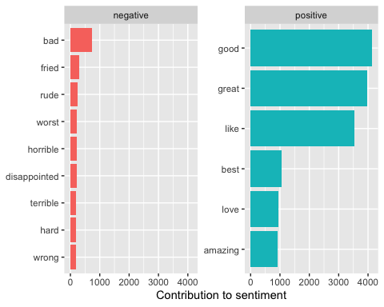

Slide 17
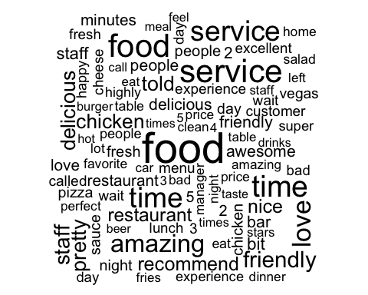
Words Clouds

Slide 18
Consecutive Words
The most common consecutive words for business in different rate group

Slide 19
Consecutive Words Plot
## Selecting by tf_idf

Slide 20
